Slide 1
AGEL Cross Functional Platform Intelligence
Transitioning from isolated single applications to integrated cross-functional intelligence with
practical, actionable insights

Slide 2
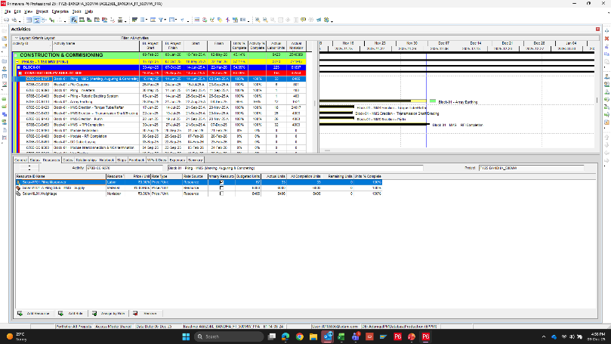
Primavera P6
For Scheduling, Planning & Resource Allocation to activities
Solution Snapshot
Current Status
All 33 Projects ( Solar, Wind & PSS ) are onboarded to P6 and being updated.
Progress updates are being released weekly to every key stakeholders.
All EPC Projects are onboarded & managed on P6
Digital DPR platform for automated daily data entry to P6 platform is under development.
P6 training sessions dedicated for AGEL have been conducted for all Sites & HO

Slide 3
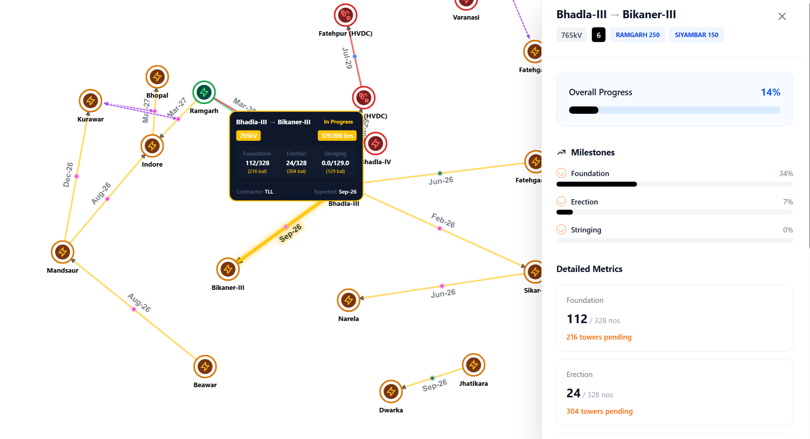
Transmission Connectivity Dashboard
To track Grid connectivity & Evacuation
Solution Snapshots
Current Status
Tracks Upstream Connectivity & Evacuation Readiness that affects project completion
Currently Excel based inputs, automated channels in progress
Tracks Grid connectivity, Line & Project Progress
Live for Khavda & Rajasthan
Spiderweb Visualization for Network

Slide 4
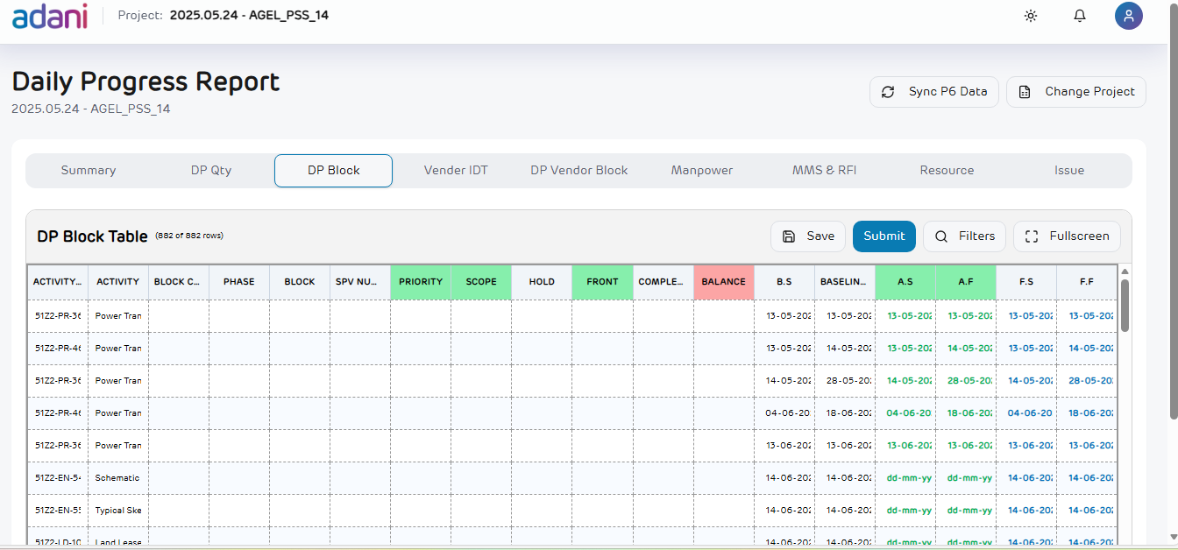
Digitalized DPR
To emphasize sync between P6 & Real-time construction updates
Solution Snapshot
Current Status
Shift from Excel based tracking to Digitalized version
Upstream & Downstream P6 integration
Human in Loop Approval Workflow
Compute Vision (Camera/Drone) integration possible for 33/48 construction activities
Notes:
We will go ahead with deck under four major sections starting how does India as a country and AGEL as a company position themselves. Subsequently we will dive into AI use cases which are helping AGEL to create sustainable value in RE sector.

Slide 5
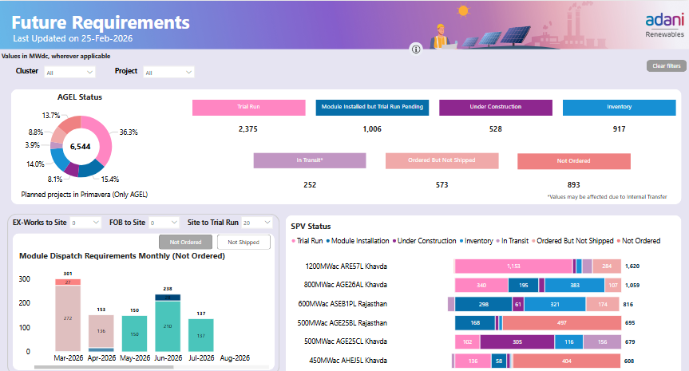
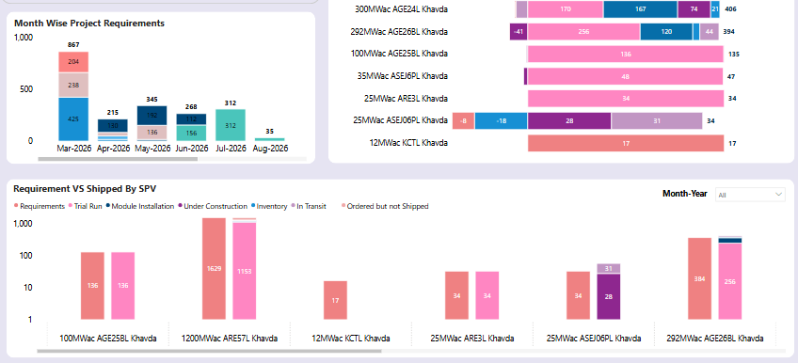
Module Tracker
To track live module planning & Updates
Solution Snapshots
Current Status
Single Dashboard combining planning (P6) & Actuals (SAP)
Early identification of delays, shortages & Cost overruns
Real-time visibility of material flow from order to site
Clear tracking of CAPEX by Project stage
Notes:
We will go ahead with deck under four major sections starting how does India as a country and AGEL as a company position themselves. Subsequently we will dive into AI use cases which are helping AGEL to create sustainable value in RE sector.

Slide 6


Immediate Plan – Drop 1 Projects (8 weeks)
TC/SCM – Push Ordering/Dispatch Dates
SAP – PO/SO Amendment
Human in Loop
Projects Head – Site Readiness
Notify
Transmission Connectivity Tracker
Finance – LC/BG/WC Decisions
Primavera P6
Excel upload in Transmission connectivity dashboard (temporary)
Phase‑2: Direct source integration (API / DB)
Digitalized DPR
Enables centralized, phase‑wise and project‑wise monitoring of transmission connectivity for Rajasthan and Khavda.
Daily Construction Program @L4/L5 level
Manpower tracking
Machinery Data
Add one more activity named as Connectivity status
Site Construction Progress
Use Cases
Detect delays in evacuation capacity
Delay Vendor PO
Delay or Reroute Shipping & Container booking
Change schedule dates/Re-Baseline
LC/BG/WC Decisions
Module Tracker
Vendor Notification
Module Movement & Tracking
Notification Layer

Slide 7
Final Plan – Drop 1 (12 weeks)
Notifications
(Enabling Human-in-the loop Approval Mechanism)
Intelligence Layer
Cross Functional Intelligence
(Single source of truth for cross functional Intelligence)
Visualization Layer
Live Data
Power BI (Multiple Dashboards)
Connectivity
(Transmission Connectivity)
Module Tracker (Module Logistics)
Historical Data
Foundation Layer
SAP (Cost)
DPR (Progress Report
P6
(Schedule)
Data Layer
(Enterprise DataLake + AGEL DataLake)
Analytics Layer
(DataBricks)
Input Layer
People
Camera
API
Web Scrapping (RPA)

Slide 8
Final Plan – Drop 2(Drop1 + 8 weeks)
Notifications
(Enabling Human-in-the loop Approval Mechanism)
Intelligence Layer
Cross Functional Intelligence
(Single source of truth for cross functional Intelligence)
Visualization Layer
Live Data
Power BI (Multiple Dashboards)
MIS (Management Reporting)
Connectivity
(Transmission Connectivity)
Module Tracker (Module Logistics)
Historical Data
Foundation Layer
IC
STF
SOP and Manuals
Resource Assessment
O&M ADLS
ENOC
SFTP
Data Layer
(Enterprise DataLake + AGEL DataLake)
Analytics Layer
(DataBricks)
Input Layer
Camera
People
IC
SCADA
Sensors
API
ENOC

Slide 9
Final Plan – Drop 3 (Drop 2 + 10 weeks)
Notifications
(Enabling Human-in-the loop Approval Mechanism)
Intelligence Layer
Cross Functional Intelligence
(Single source of truth for cross functional Intelligence)
Visualization Layer
Power BI (Multiple Dashboards)
MIS (Management Reporting)
Connectivity
(Transmission Connectivity)
Module Tracker (Module Logistics)
Live Data
Historical Data
Foundation Layer
Kronos (Manpower)
Genetec
(Security)
Trade Finance Portal
Ariba
(NFA ,Invoice)
CRM (Customer Relations)
Oracle
(HR)
Autodesk (Design)
PULSE
(HOTO & Invoice)
DRS
(Material Reconciliation
Data Layer
(Enterprise DataLake + AGEL DataLake)
Analytics Layer
(DataBricks)
Input Layer
Camera
People
Sensors
API
Web Scrapping (RPA)

Slide 10
Final Plan – Drop 4 (Drop 3 + 6 weeks)
Notifications & Approvals
(Enabling Human-in-the loop Approval Mechanism)
AI Agents
(Enabling Automated Cross-functional Workflows)
Intelligence Layer
Decision Making & Alerts (Alerts based on Current status & intelligent decision making)
Cross Functional Intelligence
(Single source of truth for cross functional Intelligence)
Visualization Layer
Live Data
Power BI (Multiple Dashboards)
MIS (Management Reporting)
Connectivity
(Transmission Connectivity)
Module Tracker (Module Logistics)
Historical Data
Foundation Layer
SAP (Cost)
IC
P6
(Schedule)
Oracle
(HR)
Kronos (Manpower)
Genetec
(Security)
PULSE
(HOTO & Invoice)
CRM (Customer Relations)
O&M ADLS
ENOC
DPR (Progress Report
Autodesk (Design)
STF
SOP and Manuals
Trade Finance Portal
Resource Assessment
Ariba
(NFA ,Invoice)
DRS
(Material Reconciliation
SFTP
Data Layer
(Enterprise DataLake + AGEL DataLake)
Analytics Layer
(DataBricks)
Input Layer
Camera
People
IC
SCADA
Sensors
API
Web Scrapping (RPA)

